Slide 1
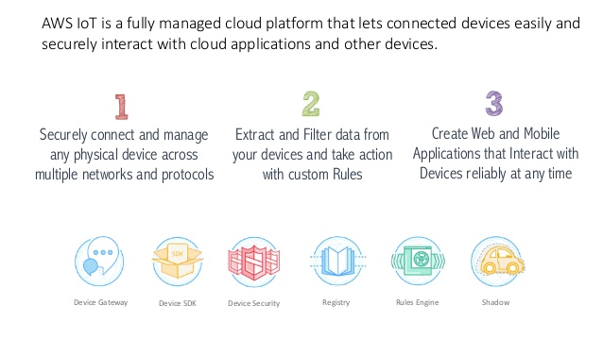

Slide 2
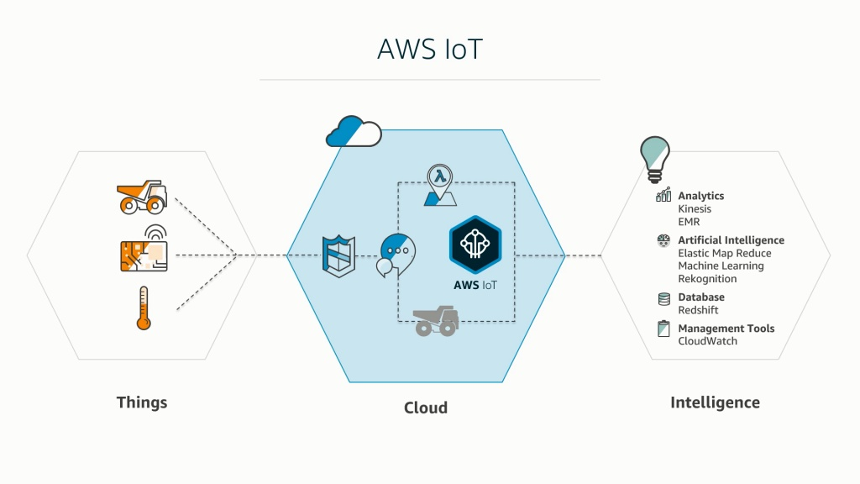

Slide 3
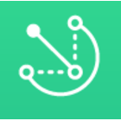
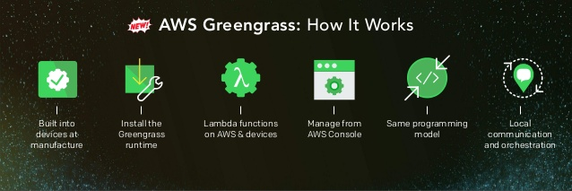
AWS Greengrass

Slide 4
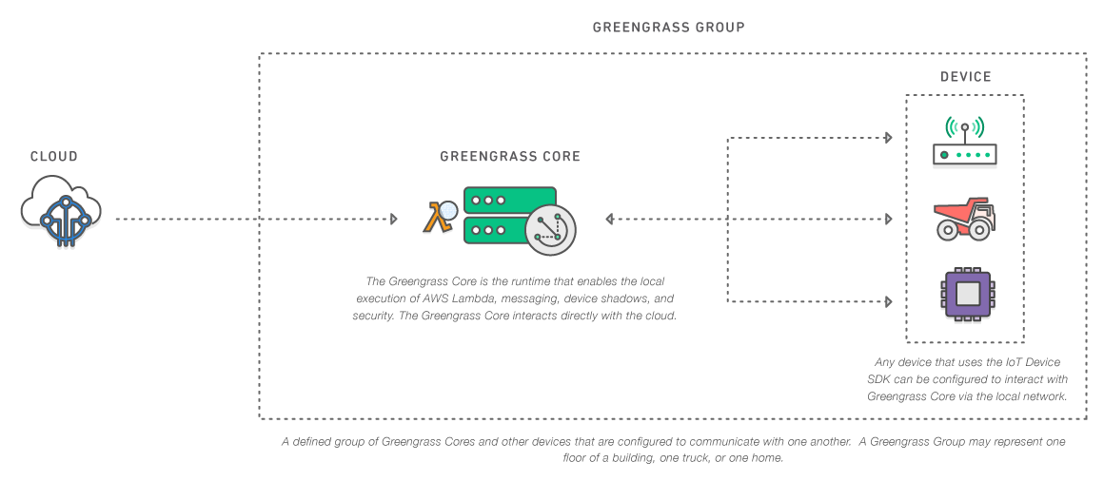
Introduction to AWS Greengrass
Greengrass is a new addition to the AWS Iot platform that enables the execution of Lambda functions, data caching, messaging and computation capabilities on IOT devices.
AWS Greengrass makes AWS IOT a more suitable platform for field services scenarios on which devices need to execute logic and perform computations locally without relying on internet connectivity.

Slide 5
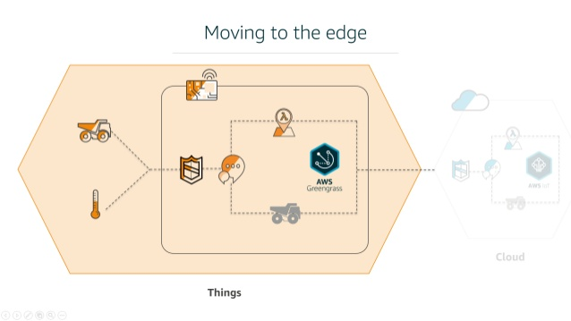

Slide 6
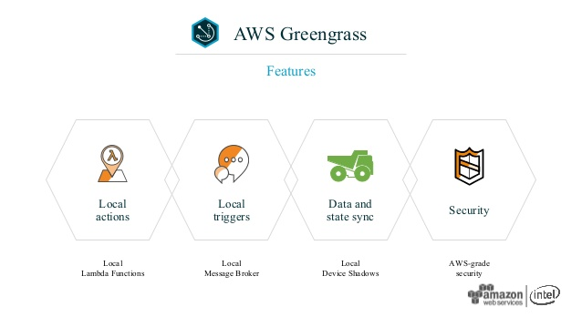

Slide 7
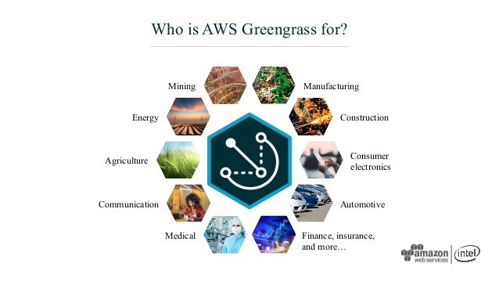

Slide 8
How useful is AWS Greengrass for us?
Greengrass allows customers to locally execute Lambda functions that are triggered by local events, messages from the cloud, or other desired sources.
AWS Greengrass enables devices to securely communicate on a local network and exchange messages with each other without having to connect to the cloud.
Moreover, Greengrass provides a local pub/sub message broker that can intelligently buffer messages in the event of lost connectivity, so that inbound and outbound messages to the cloud can be buffered.
AWS Greengrass provides convenient fleet management of devices through secure over-the-air updates of software versions and Lambda functions. In this way, customers can scale their IoT solutions by centrally administering devices, permissions, applications from the cloud.
By using Greengrass for local execution, customers can be selective about the data that should be processed and stored locally versus the most valuable data that should be processed and stored in the cloud.

Slide 9
Hardware specification for greengrass devices
At least 1GHz of compute (either ARM or X86)
128MB of RAM
Operating Systems: Ubuntu 14.04 LTS, Jessie Kernel 4.1/4.4, and other Linux distributions with Kernel 4.4 or greater
CPU Architectures: x86_64, Armv7, Aarch64 (ArmV8)
Additional resources to accommodate the desired OS
Message throughput
AWS Lambda execution depending on the use case
Highly versatile, Greengrass Core can run on devices that range from a Raspberry Pi to a server-level appliance.
Any Lambda that uses the Python 2.7 Runtime can be deployed to Greengrass Core.
Please note: Some cloud services that your Lambda relies upon (e.g. DynamoDB) will not be available to your Lambda functions when Greengrass Core is in offline mode, and API calls to those services will fail in offline mode.

Slide 10
AWS Greengrass Availability
It is available in the following AWS regions:
• US East (N. Virginia)
• US West (Oregon)
• EU (Frankfurt)
• Asia Pacific (Sydney)
You can use AWS Greengrass regardless of your geographic location, as long as you have access to one of the above AWS regions.

